Slide 1
Productivity Performance and Government Policy
Andrew Sharpe
Executive Director, Centre for the Study of Living Standards
Annual Meeting of the Canadian Economics Association
Laval University
Quebec, Quebec
Saturday, May 29, 2010

Slide 2
Outline of Presentation
I Canadian Productivity Performance
Overall Productivity Trends
A Growth Accounting Perspective
An Industry Perspective
A Provincial Perspective
Impact of the Reallocation of Labour
II Productivity Drivers and the State of Policies Affecting Productivity
Investment
Innovation
Human Capital
Macroeconomic Framework Policies
Microeconomic Framework Policies
III Policy Priorities for Improved Productivity in Canada

Slide 3
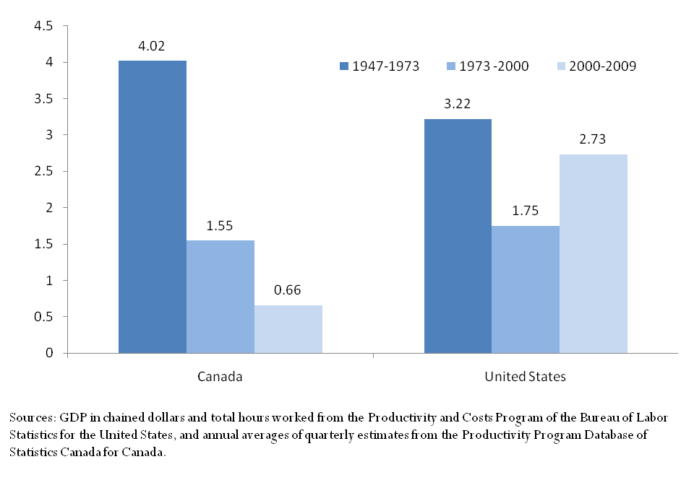
Real Output per Hour Growth, Business Sector, Canada and the United States, Per Cent, 1947-2009
Average Annual Rates

Slide 4
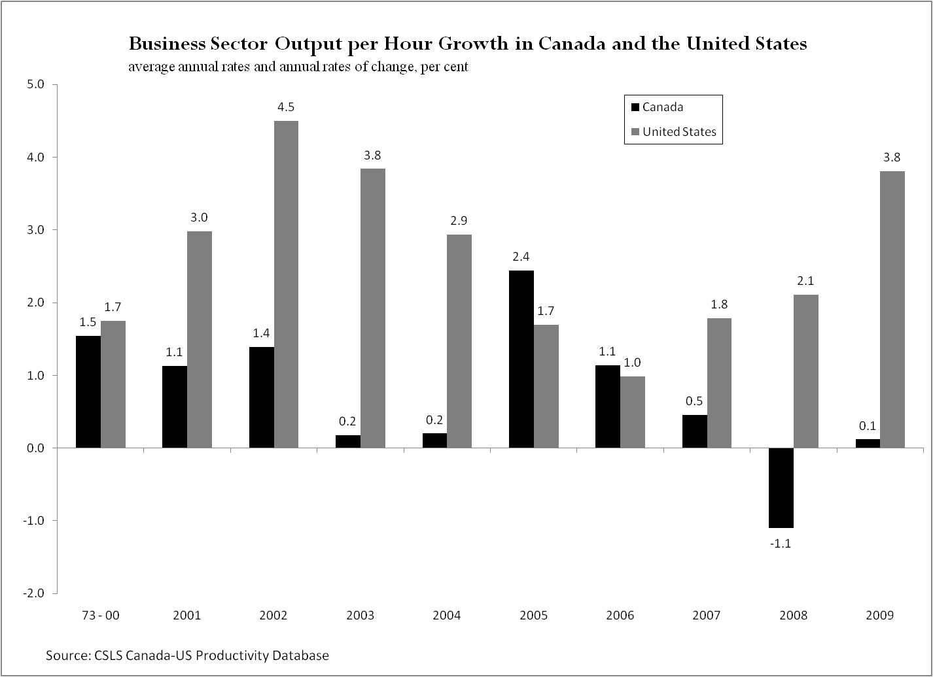

Slide 6
Chart 3: GDP per Hour Worked Growth in OECD Countries, 2000-2007 (Compound Annual Rate of Growth, Per Cent)

Slide 7
Productivity Elasticity, Business Sector, Canada and the United States, 1947-2007

Slide 8
Sources of Labour Productivity Growth in the Canadian Business Sector, 1973-2000 and 2000-2007
 | 1973-2000 | 2000-2007 |  | Post-2000 Change
 | A | B |  | B - A
Average Annual Rate of Growth
Output | 3.35 | 2.59 | -0.76
Total hours | 1.66 | 1.51 | -0.15
Labour composition | 0.60 | 0.54 | -0.06
Capital services | 4.65 | 3.90 | -0.75
Capital stock | 2.86 | 2.49 | -0.36
Capital composition | 1.75 | 1.35 | -0.39
ICT capital services | 19.56 | 10.17 | -9.38
Non-ICT capital services | 3.54 | 3.24 | -0.31
Capital services intensity | 2.94 | 2.35 | -0.59
ICT cap. serv. Intensity | 17.60 | 8.53 | -9.08
Non-ICT cap. serv. Intensity | 1.85 | 1.70 | -0.16
Average Annual Percentage Point Contributions to Labour Productivity Growth
Labour productivity | 1.66 | 1.06 | -0.60
Labour composition | 0.36 | 0.31 | -0.05
Capital services intensity | 1.15 | 1.01 | -0.14
Capital stock intensity | 0.70 | 0.68 | -0.02
Capital composition intensity | 0.43 | 0.32 | -0.11
ICT cap. serv. Intensity | 0.46 | 0.34 | -0.13
Non-ICT cap. serv. Intensity | 0.67 | 0.66 | -0.01
Multifactor productivity | 0.15 | -0.26 | -0.41
Average Annual Percent Contributions to Labour Productivity Growth
Labour productivity | 100.0 | 100.0 | 100.0
Labour composition | 21.7 | 29.6 | 7.8
Capital services intensity | 68.9 | 95.2 | 22.8
Capital stock intensity | 42.2 | 64.3 | 3.5
Capital composition intensity | 25.9 | 30.3 | 18.2
ICT cap. serv. Intensity | 27.8 | 31.7 | 20.9
Non-ICT cap. serv. Intensity | 40.5 | 62.5 | 1.8
Multifactor productivity | 8.9 | -24.5 | 67.5
Source: CSLS Calculations based on the Canadian Productivity Accounts from Statistics Canada, CANSIM Table 383-0021.

Slide 9
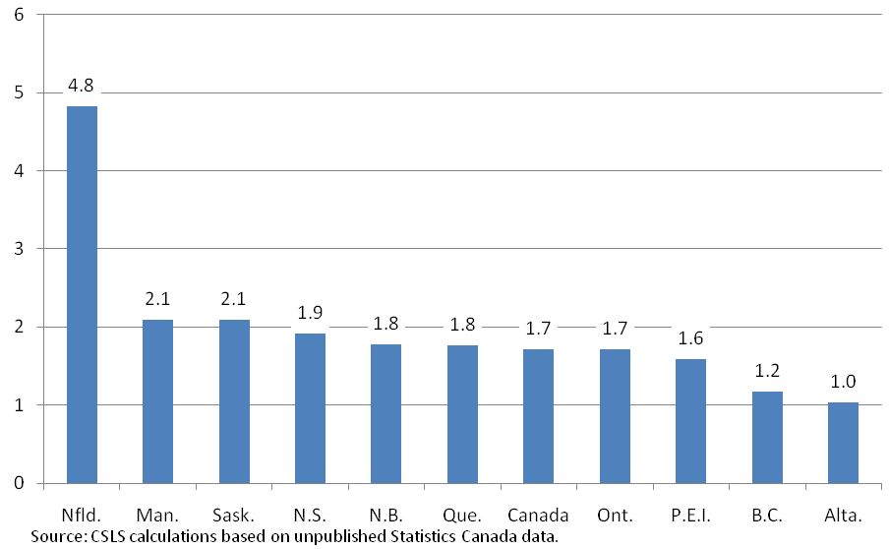
Labour Productivity Growth by Province, 1997-2007 Average Annual Rate of Growth

Slide 10
Capital Productivity Growth by Province, 1997-2007 Average Annual Rate of Growth

Slide 11
Multifactor Productivity Growth by Province, 1997-2007 Average Annual Rate of Growth

Slide 12
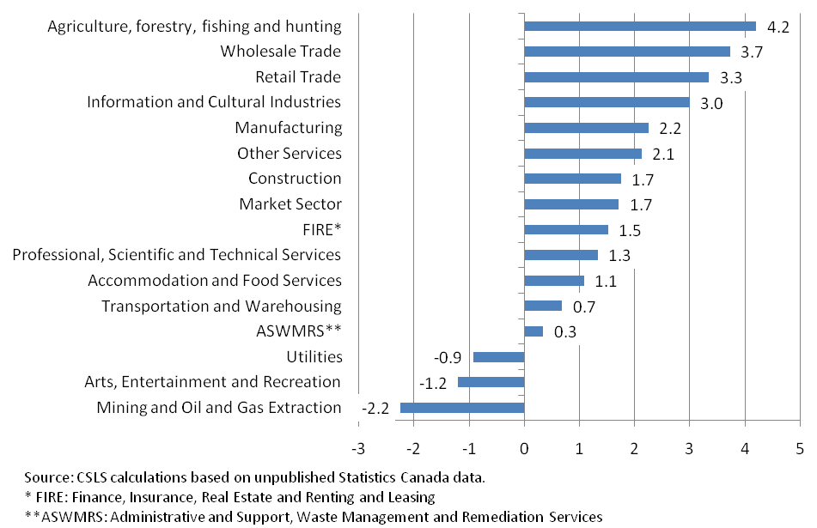
Labour Productivity Growth by Industry in Canada, 1997-2007 Average Annual Rate of Growth

Slide 13
Capital Productivity Growth by Industry in Canada, 1997-2007 Average Annual Rate of Growth

Slide 14
Multifactor Productivity Growth by Industry in Canada, 1997-2007 Average Annual Rate of Growth

Slide 15
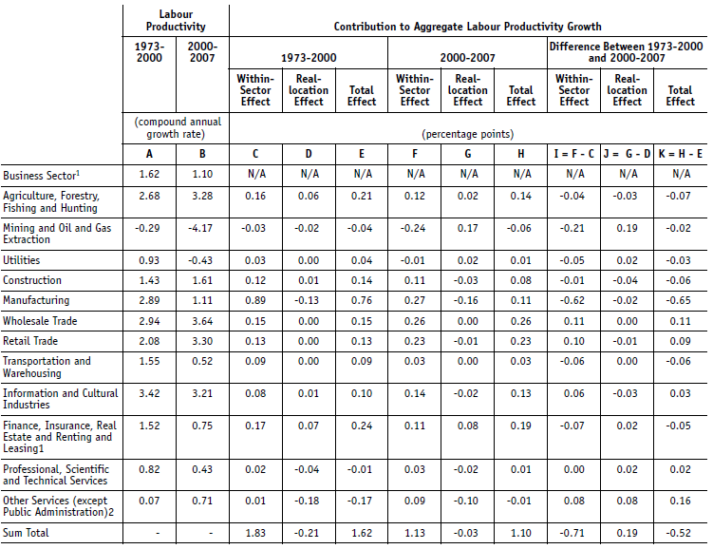
A Comparison of Sectoral Contribution in 1973-2000 and 2000-2007 period Divided into Within-Sector and Reallocation Effects

Slide 16
Investment
Weaknesses
Low share of machinery and equipment investment in GDP
Low share of ICT investment in GDP
Long-term decline in public investment as a share of GDP
Policy Reponses
Introduction of the HST in Ontario and British Columbia to reduce the marginal effective tax rte (METR) on investment
Reduction in the statutory federal corporate tax rate
Special incentives for ICT investment
Increased infrastructure spending

Slide 17
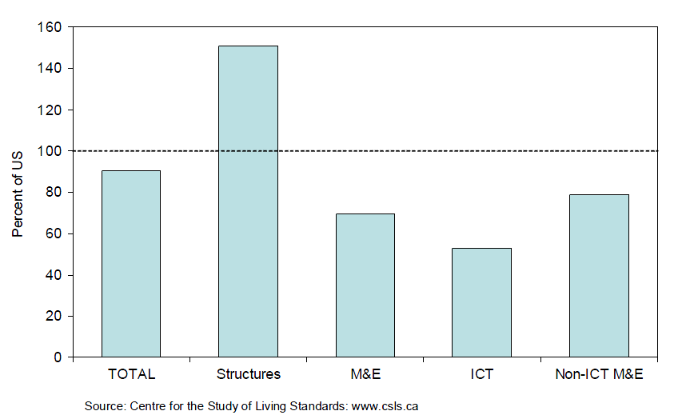
Business Investment per Worker
Canada as a per cent of the US (Average 1985 – 2005)

Slide 18
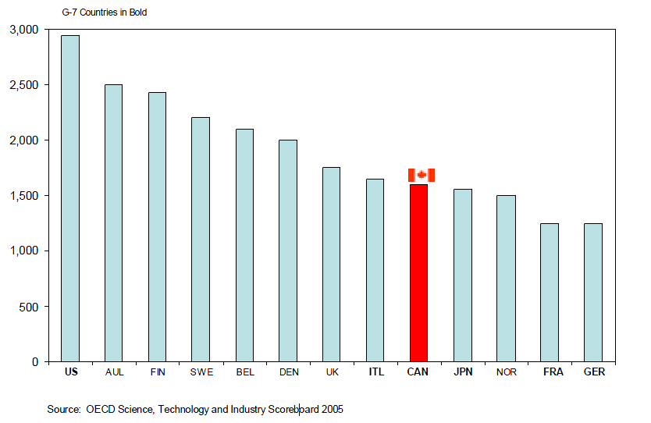
ICT Investment per Employed Person – 2002

Slide 19
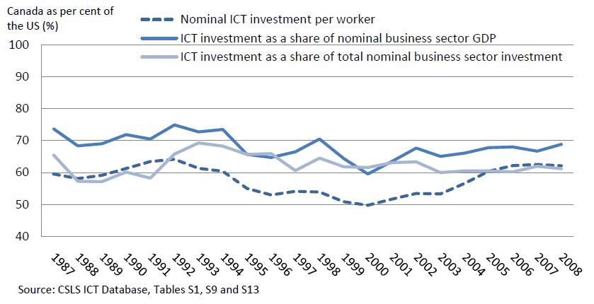
The Canada -United States ICT Investment Gap by Indicator (Canada/US)

Slide 20
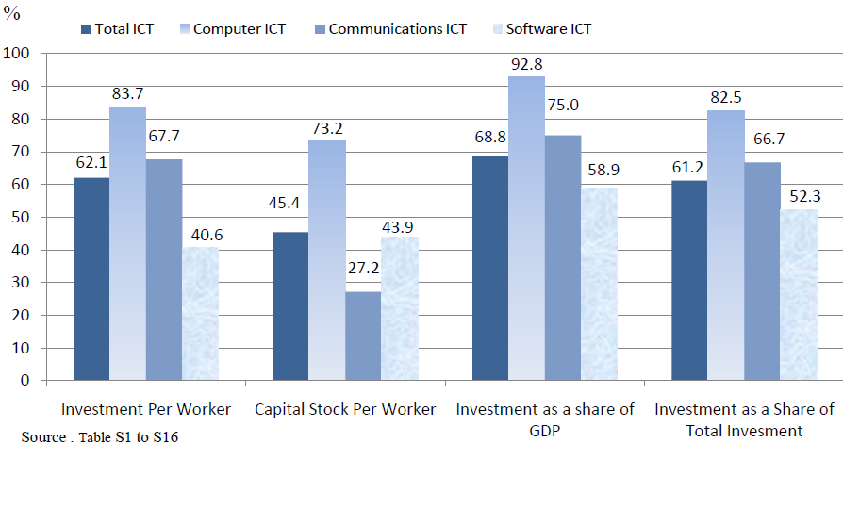
The Canada-US ICT Gap, Canada as a proportion of the United States, 2008

Slide 21
Innovation
Weaknesses
Very weak technical progress, as implied by the poor performance of total factor productivity growth
Low business sector R&D intensity
Weak linkages between university research and business innovation
Policy Responses
Generous tax incentives for business R&D
Increased government support for higher education R&D
Exhortation for better university-business technological partnerships

Slide 22
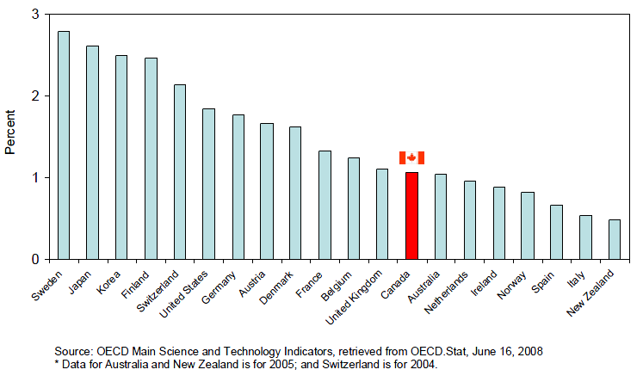
Business R&D Intensity – Business Expenditure on R&D as a Percentage of GDP

Slide 23
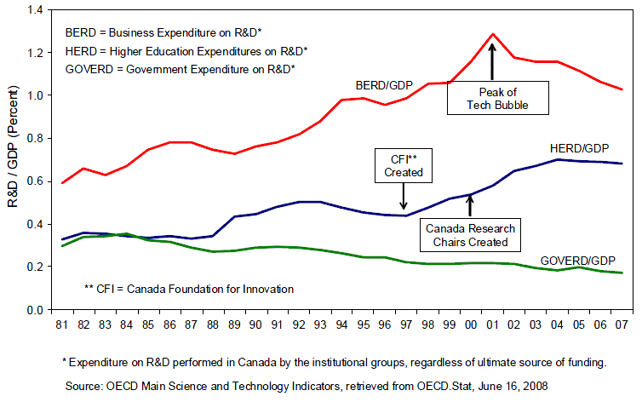
Trend Components of R&D Intensity in Canada

Slide 24
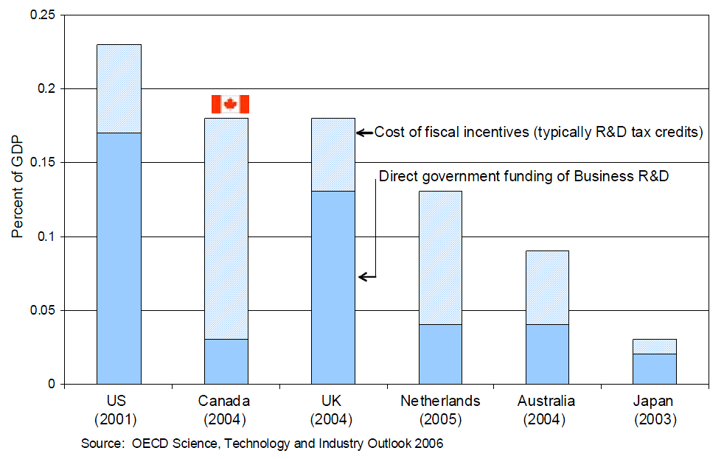
Government Funding of Business R&D
Per cent of GDP

Slide 25
Human Capital
Strengths
Highest proportion of the population with a post-second education among OECD countries
High PISA scores for high school students
World class research universities
Weaknesses
Relatively low proportion of the population with graduate degrees
Low completion rate for apprenticeship programs
Underutilization of the human capital of recent immigrants
Low levels of human capital of Aboriginal Canadians
Poor literacy skills for a significant proportion of the workforce
Policy Responses
Better recognition of foreign credentials
Greater emphasis on high school completion with an increase in the age of compulsory schooling to 18 in Ontario and New Brunswick

Slide 26
Macro-economic Framework Policies
Stable inflation through inflation targeting
Low debt/GDP and deficit/GDP ratios by international standards
Improved fiscal position in the medium term due to recovery and spending cuts

Slide 27
Micro-economic Framework Policies
Market-oriented approach to framework policies as evidenced by privatization of Crown corporations, deregulation of certain sectors (e.g., telecommunications) and apparent easing of foreign ownership restrictions
Canada already one of the most market-oriented economies in the world
Still some interprovincial barriers to trade (e.g. provincial procurement policies) and labour mobility (recognition of professional credentials)
Still foreign ownership rules in certain sectors
Marketing boards with controls on domestic production and imports are the most important barrier to international trade

Slide 28
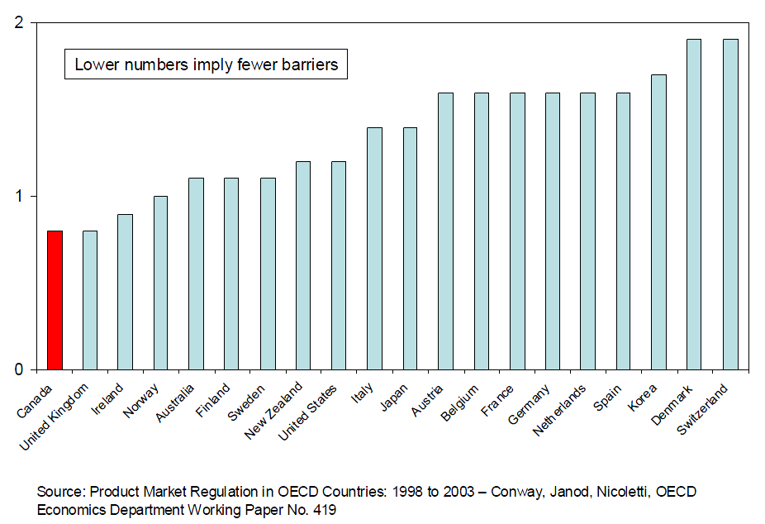
Index of Barriers to Entrepreneurship - 2003

Slide 29
Market Regulation, Canada, 1975 and 2003

Slide 30
Policy Priorities for Improved Productivity Growth in Canada
Greater assistance for technology transfer and adoption of best practice techniques by small and medium-sized firms
Rebalancing of government assistance to business R&D from tax incentives to direct support, and to technology transfer programs
Gradual winding down of marketing boards with production quotas through buy-outs
Greater emphasis on graduate education
Objective of virtually universal high school completion by moving the compulsory schooling age to 18
Increased emphasis on upgrading the skills of Aboriginal Canadians
More effective policies to improve the utilization of the human capital of immigrants

